Slide 1



Real-Time Customer Analytics at Braze
BRAND LOGO HERE

Slide 2



Me
Caleb Severn Senior Engineering Manager Braze

Slide 3
What is Braze?
Lifecycle of Platform Events
Revamping Analytics
Topics

Slide 4
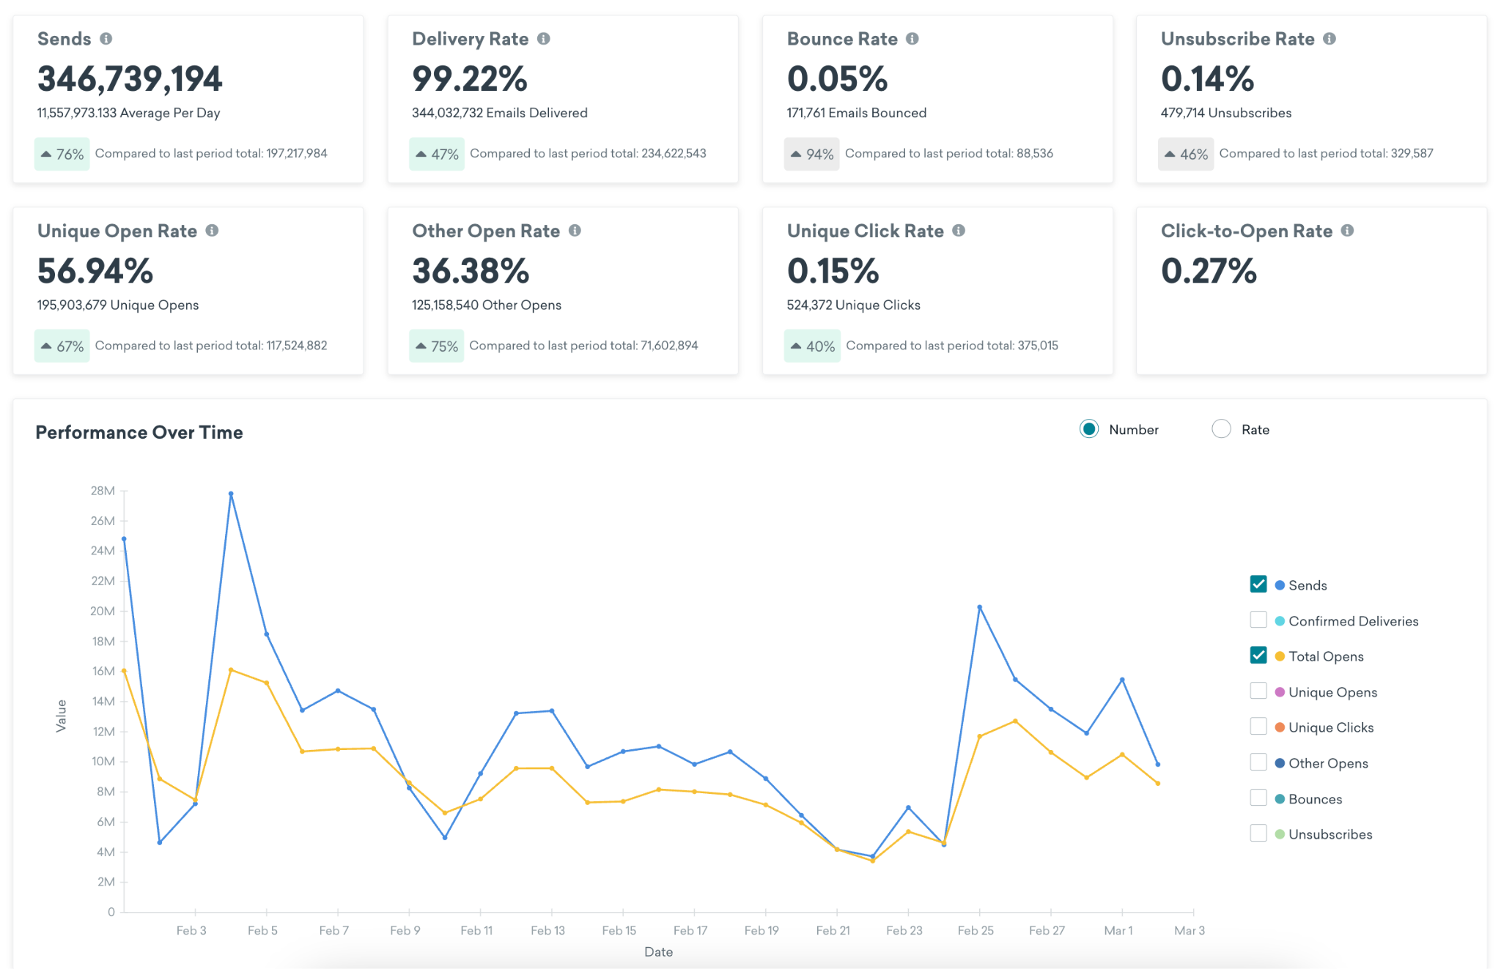
What is Braze?
Braze is a multi-channel customer engagement platform
Simple reporting loop:
Sending marketing campaigns
Recording end-user actions
Real-time reporting on this event data
(repeat)

Slide 5
How much data are we talking about?
25T+
>PB
~14B
Trillions of events
Petabyte Scale
Up to 14 billion messages sent per day

Slide 6

Lifecycle of Platform Events

Slide 7
Kafka
Snowflake
EventProcessor
Event
MongoDB Writer
MongoDB
Notes:
Use cases for MongoDB vs Snowflake, current use of Snowflake for more complex analysis but also debugging, data sharing.

Slide 8
What’s wrong with having two event pipelines?
Well, when they’re used for the same thing:
Delivery semantics
Data integrity (e.g. across reports)
Infrastructure cost / management
Maintenance
Notes:
Any issue in one system creates inconsistencies, anything unexpected is much harder to manage. At this scale, we overwhelm mongo or have to deal with an intermediary system

Slide 9
What can we do about it?
Use Mongo for everything
Use Snowflake for everything
Some secret third option

Slide 10

Revamping Analytics
(with ClickHouse)

Slide 11
Snowflake
EventProcessor
Kafka
Event
???

Slide 12
Reporting requirements
Managed service (but also decent local dev tooling)
Large scale data ingestion (from Kafka)
Fast aggregations (compare to MongoDB)
High read volume (10-50qps)
Not outrageously expensive
“Real time”
Many platforms check most of these boxes, but not all
Notes:
Current usage of MongoDB for massive queries. Had to build bespoke map/reduce pipeline to allow reporting across hundreds of campaigns, or very long time periods.

Slide 13
Snowflake
EventProcessor
Kafka
Event
ClickHouse
https://clickhouse.com/docs/integrations/kafka/clickhouse-kafka-connect-sink
Notes:
Use cases for MongoDB vs Snowflake, current use of Snowflake for more complex analysis but also debugging, data sharing.

Slide 14
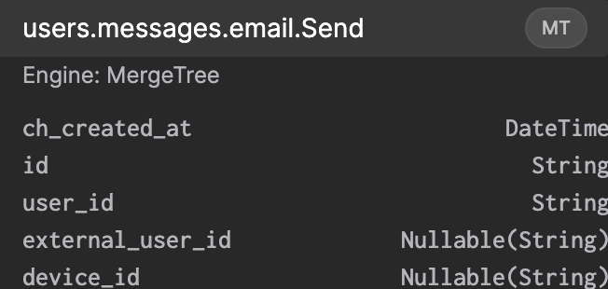
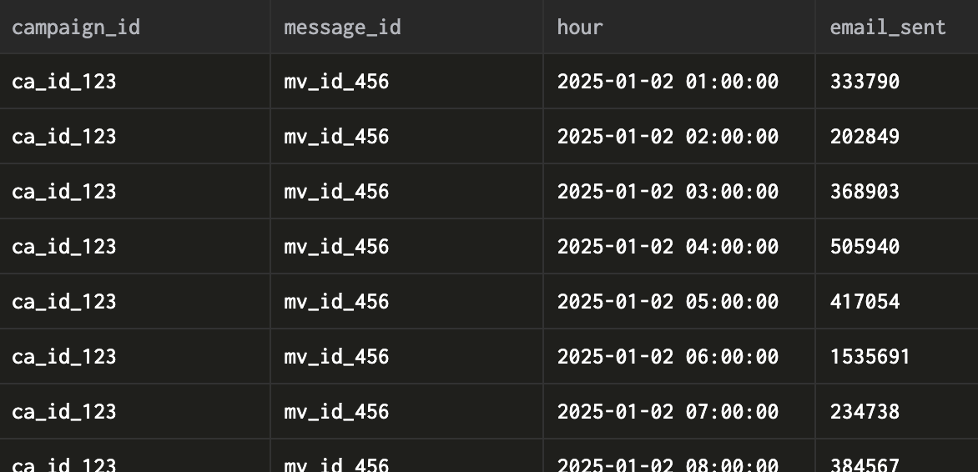
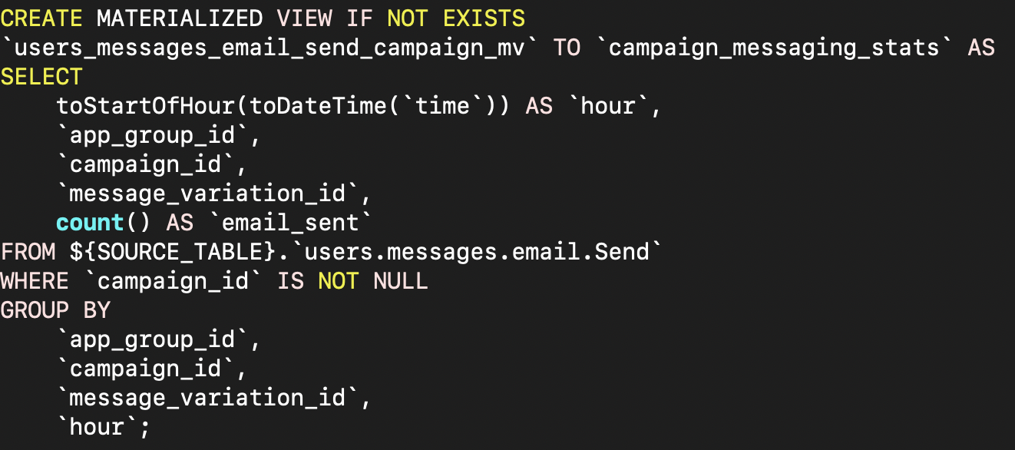
AggregatingMergeTree
SimpleAggregateFunction(sum, UInt64)

Slide 15

Querying ClickHouse

Slide 16
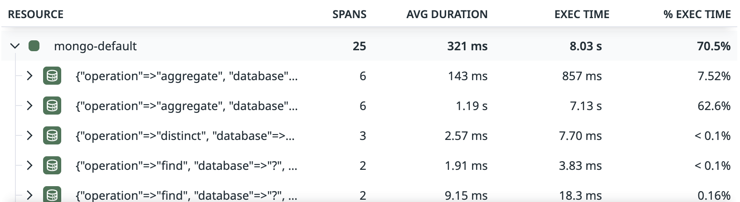
Querying MongoDB

Slide 17
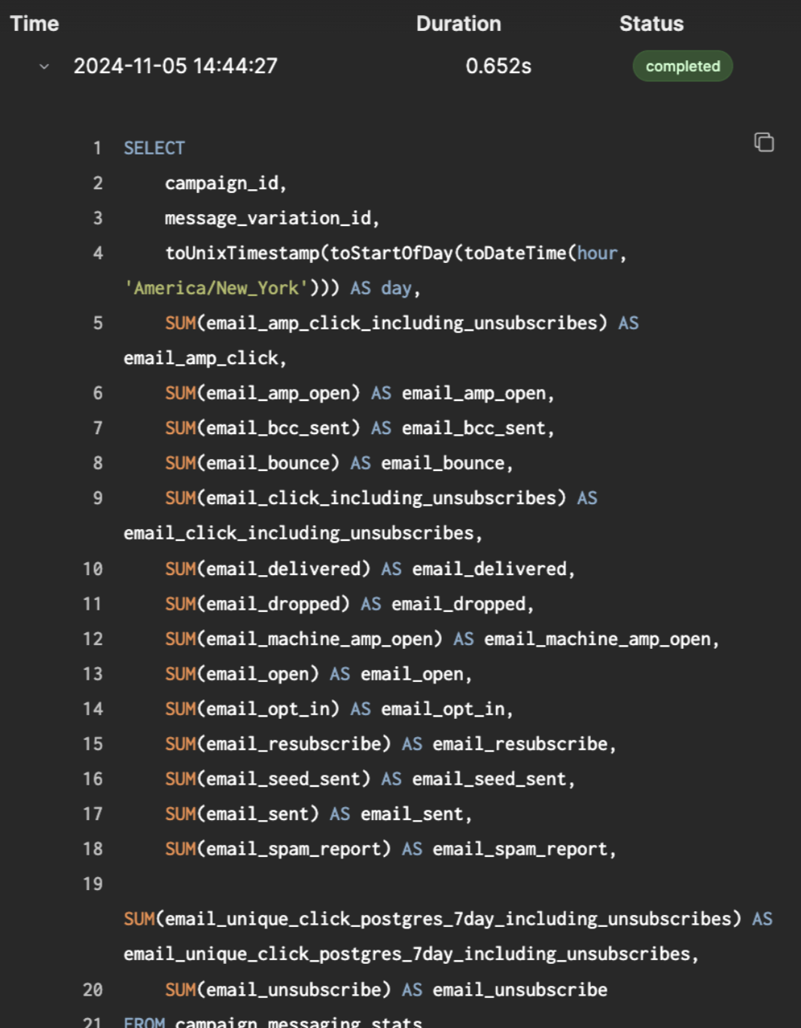
Querying ClickHouse
Fast[er than Mongo]
Consistent with Snowflake
Abstracts aggregation layer, tz conversions

Slide 18
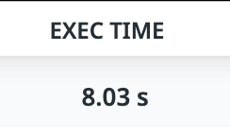
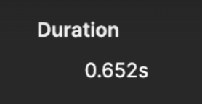
Querying ClickHouse

Slide 19
What’s Next?
Observability (Elasticsearch)
Finish migrating legacy pipelines
More complex use cases (user segmentation, attribution)

